Slide 1

Early Detection of Diabetes Disease By Using Machine learning

Slide 2
Contents
Abstract
Problem statement
Introduction
Flow Diagram
Proposed Methodology
Prediction Results
Conclusion

Slide 3
ABSTRACT
We use machine learning algorithms to identified Diabetes disease. The study made use of a dataset that included decisions regarding diagnosis from people with and without Diabetes disease. Handling missing data and scaling features were part of the preprocessing processes that made sure the model performed as best it could. We trained and assessed two different machine learning algorithms: Random Forest, Decision Tree. We used common measures such receiver operating characteristic (ROC) curves, confusion matrix analysis, and accuracy.

Slide 4
Problem Statement
Early Detection of Diabetes Disease using Machine Learning

Slide 5
Introduction
Predicting diabetes at an early stage is crucial for preemptive healthcare management and lifestyle adjustments aimed at prevention or control. This chronic disease affects individuals across all age groups. Machine learning algorithms play a pivotal role in identifying potential diabetes risks through predictive modeling. By analyzing relevant health data, these algorithms facilitate early detection, enabling timely interventions and personalized strategies. Such proactive measures can significantly mitigate the onset or progression of diabetes, thereby improving overall health outcomes and quality of life.

Slide 6
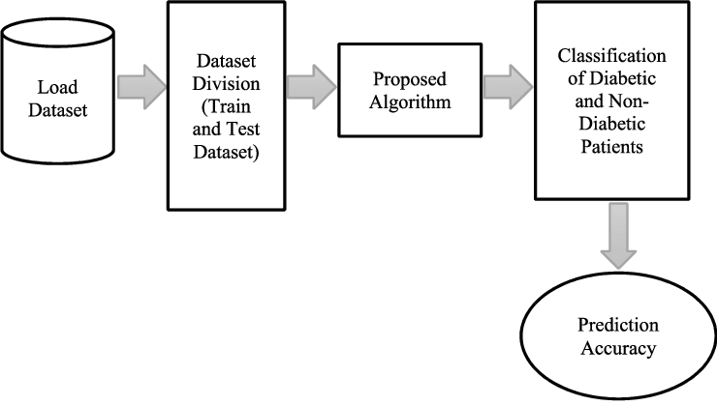
Flow Chart

Slide 7
Proposed Methodology
Two different machine learning algorithms:
Decision Trees:
Random Forest:

Slide 8
Decision Trees
One kind of supervised machine learning technique used for both regression and classification tasks are the decision tree . They are a popular option because of their versatility, interpretability, and simplicity in a wide range of applications . Based on the value of a feature, a decision tree is a hierarchical structure that recursively divides the data into smaller groups.

Slide 9
Random Forest
Random forests are a powerful ensemble learning algorithm that combines multiple decision trees to create a more robust and accurate model . They are based on the idea of bagging, which involves building multiple models on different subsets of the data and averaging their predictions to improve the overall accuracy.

Slide 10
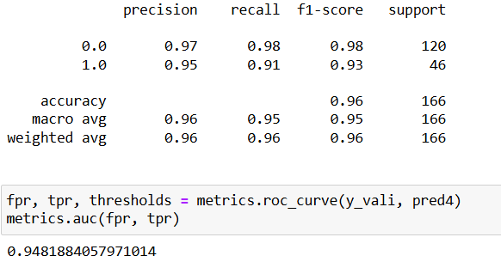
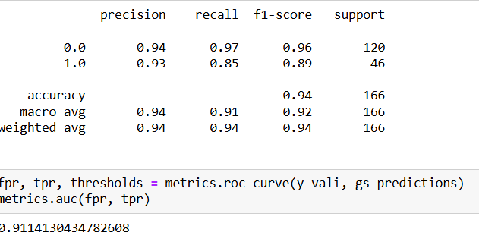
Prediction Results
Random forest model
Decision tree model

Slide 11
CONCLUSION
In conclusion, leveraging machine learning algorithms for early prediction of diabetes holds immense promise for public health. By enabling timely interventions and lifestyle adjustments, these technologies empower individuals to proactively manage their health and reduce the burden of diabetes. Continued research and application of machine learning in healthcare are essential for advancing preventive strategies and improving outcomes for individuals at risk of or living with diabetes.

Slide 12
THANK YOU
- Anantha Ramesh Reddy Varra

